Slide 1

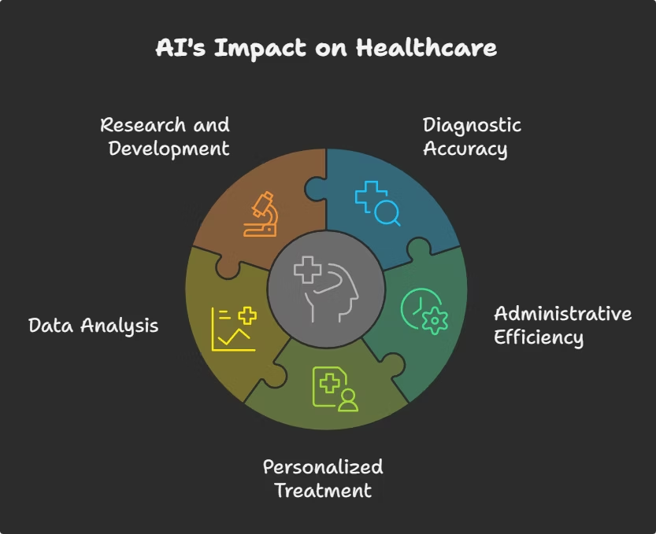

Revolutionizing Healthcare with AI
AI is transforming diagnostics, treatment, and patient care globally.
The market will reach $187.95B by 2030 at 37.7% CAGR.
It drives better outcomes and greatly improves healthcare efficiency.
by Merlin Valanarasu

Slide 2

AI-Powered Diagnostics
Accurate Imaging
Wide Condition Detection
AI detects tumors in mammograms with 96% accuracy.
Google’s AI identifies 26 skin conditions with over 90% accuracy.
Error Reduction
Diagnostic errors reduce by up to 85% with AI support.

Slide 3

Personalized Treatment Plans
Tailored Care
AI creates customized treatment plans based on patient data.
Drug Response Prediction
Predicts patient reactions to drugs with 88% accuracy.
Optimal Dosages
Recommends the best drug dosages to reduce side effects.
Adverse Reaction Reduction
Adverse drug reactions drop by 22% thanks to AI guidance.

Slide 4
Enhanced Patient Care
Virtual Assistants
Remote Monitoring
Reduced Readmissions
AI chatbots provide round-the-clock patient support and scheduling help.
Systems continuously track vital signs to detect health changes early.
Hospital readmissions have fallen by 15% through AI-powered care.

Slide 5





Streamlined Administrative Tasks
Automation
Claim Processing
Cost Reduction
AI automates time-consuming administrative healthcare tasks.
Insurance claims processed with 95% accuracy using AI.
Administrative costs drop up to 30% via AI systems.
Fraud Prevention
Improves billing accuracy and detects fraudulent claims efficiently.

Slide 6




Challenges and Ethical Considerations
Bias Risks
Data Requirements
AI algorithms may reflect biases if training data is unbalanced.
AI requires large, diverse datasets to train effectively.
Privacy Concerns
Data privacy and security are critical for AI in healthcare.
Transparency
Explainability is needed for trust and ethical AI use.
2
3
1
4

Slide 7

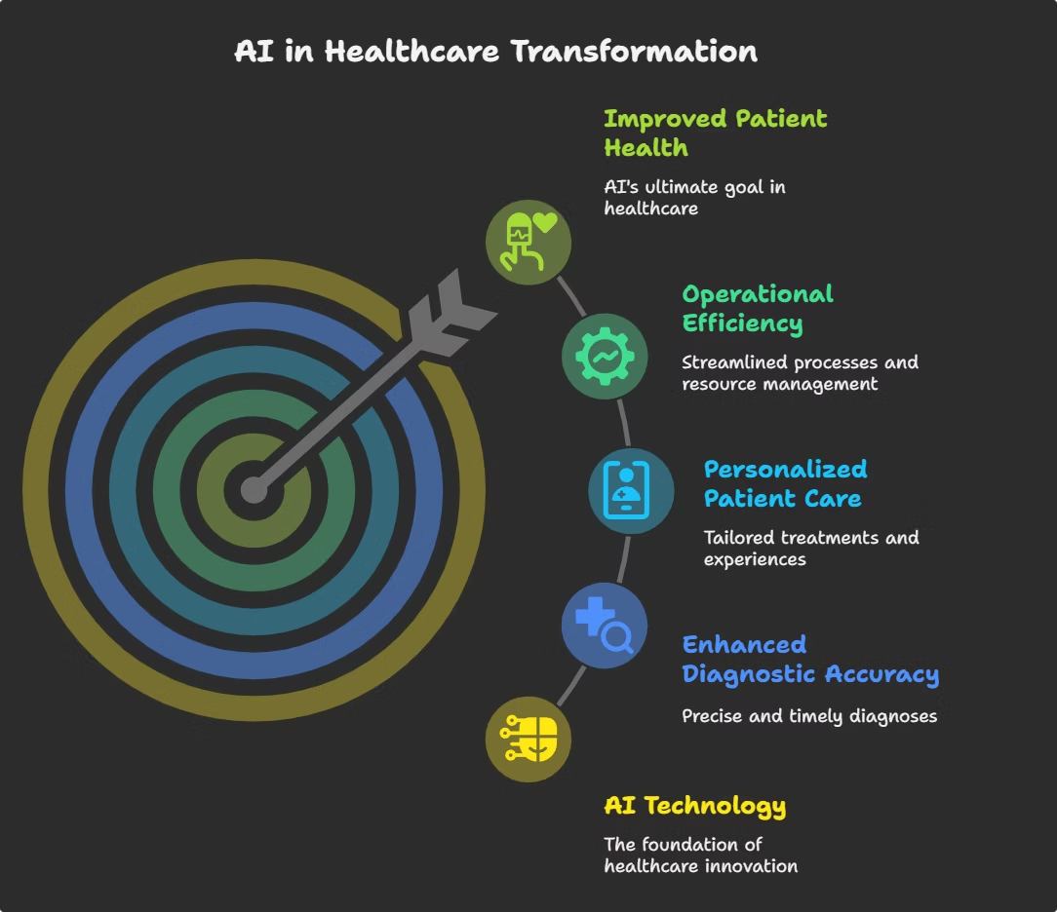
The Future of AI in Healthcare
Drug Discovery
AI accelerates development of new medications.
Personalized Medicine
Treatments tailored to individual genetics.
Predictive Analytics
Identifies and manages disease outbreaks faster.
Wearable Integration
AI powers smarter, proactive health monitoring devices.

Slide 8





Embracing the AI Revolution
Careful Planning
Adoption requires strategy and readiness for change.
Ethical Use
Focus on responsible and transparent AI practices.
Collaboration
Partnership between clinicians and AI experts is essential.
Enhancement
AI augments human abilities, not replaces healthcare workers.

